Slide 1
This is Me
By Amelia Weiss

Slide 2
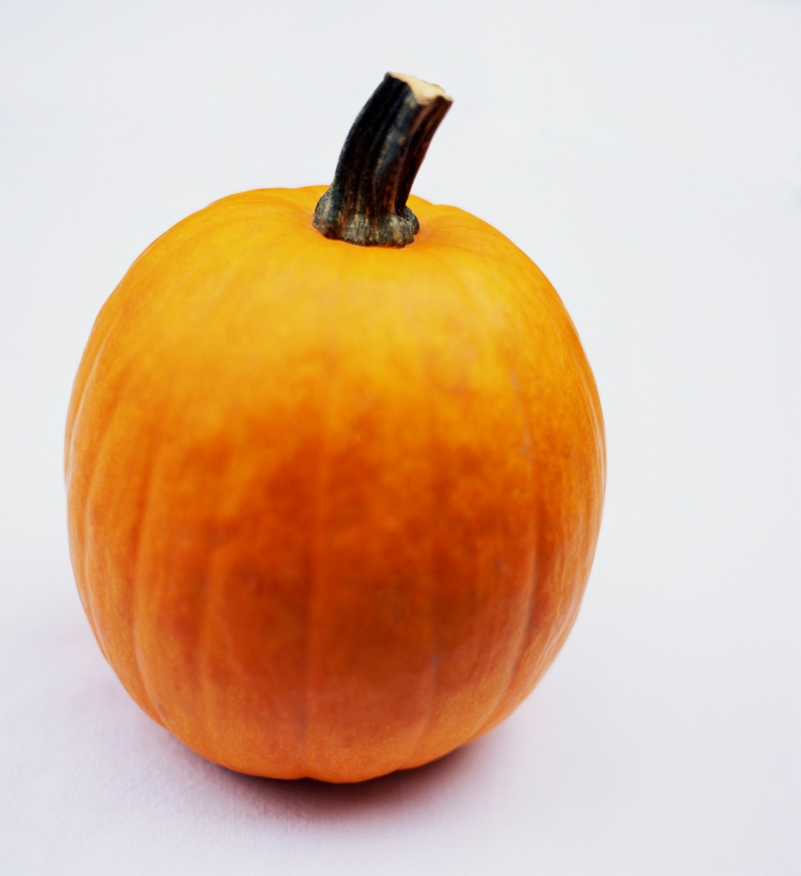
When I Was Born
I was born in St. Louis, Missouri on October 27, 2004.

Slide 3

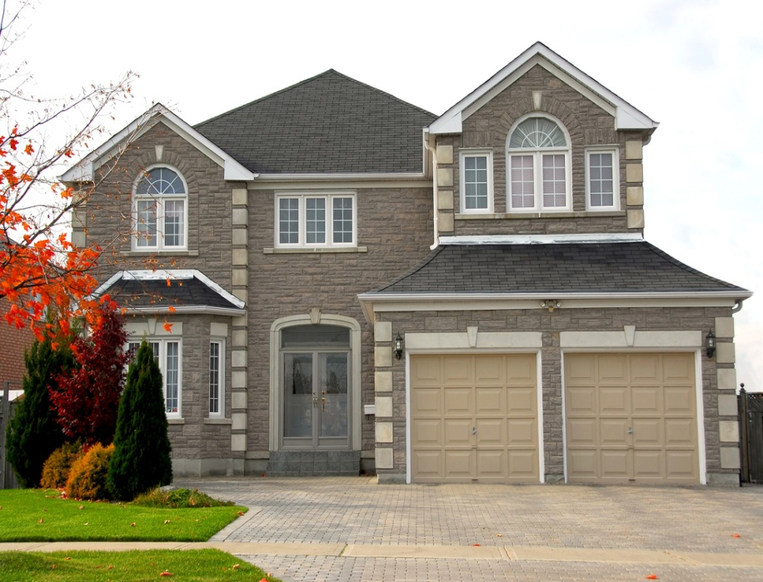
My Family
I live with my Mommy and Daddy. I have a brother (Will) and a dog (Sammy) . I love them all.

Slide 4
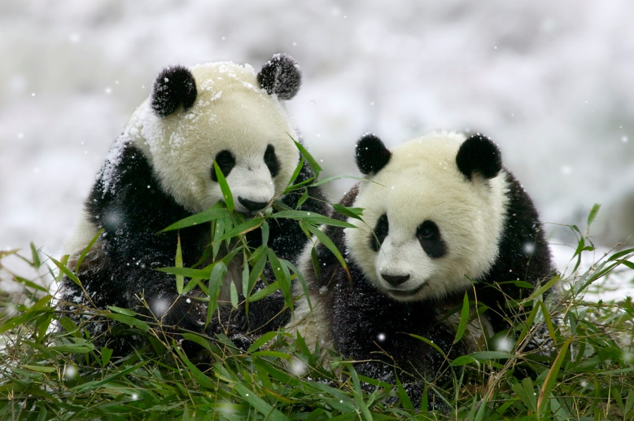
What Do I Like ?
I love pandas. French-fries and hamburgers are my favorites. I love pandas.

Slide 5
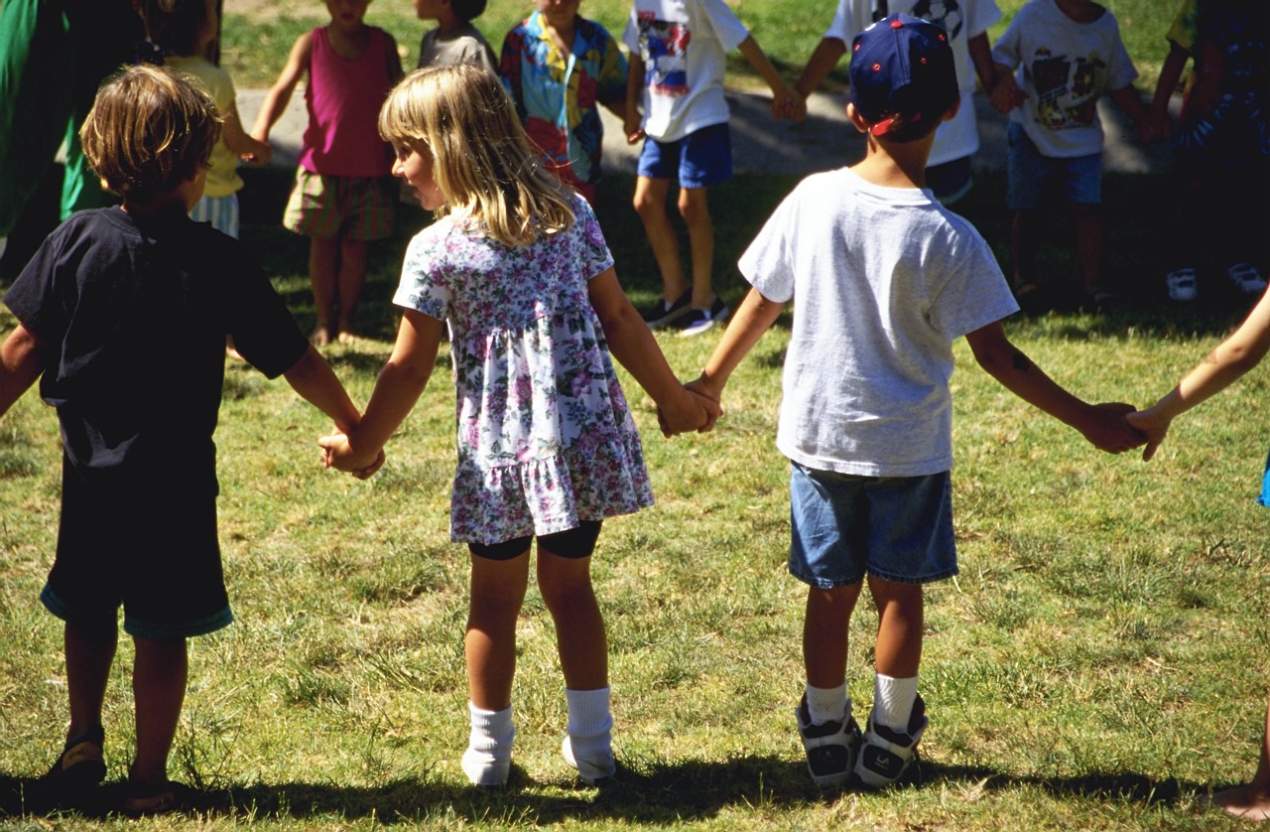
My Hobbies
I love to play outside with my friends , I love it so much! I love make things like pot holders and more.

Slide 6
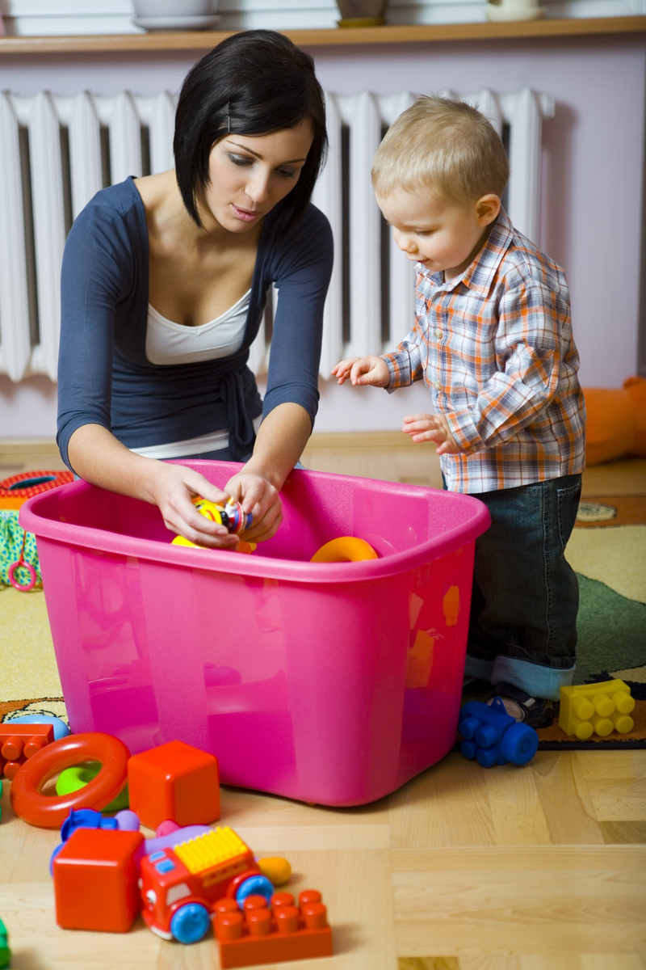
My Goals Are . . .
When I grow up I want to be a babysitter because I love being with little kids . I want to help clean up the Earth too.

