Slide 1
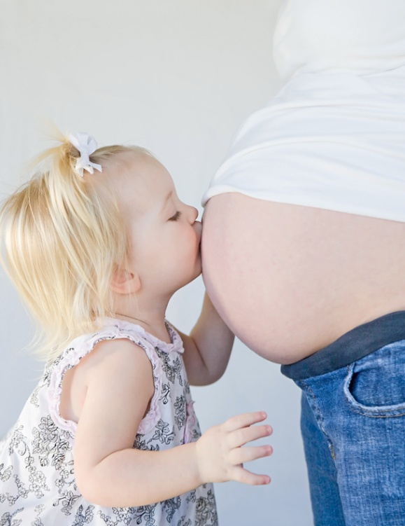
My Amazing Life Of Megan
By : Megan Margert O.

Slide 2
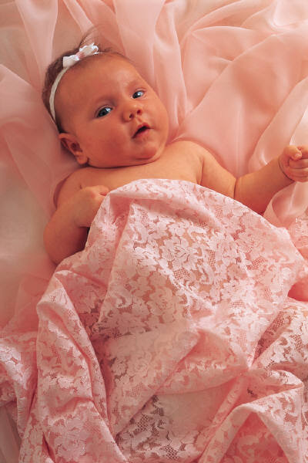
When I Was Born
I was born on November 29, 2004 in St. Louis, Missouri.

Slide 3
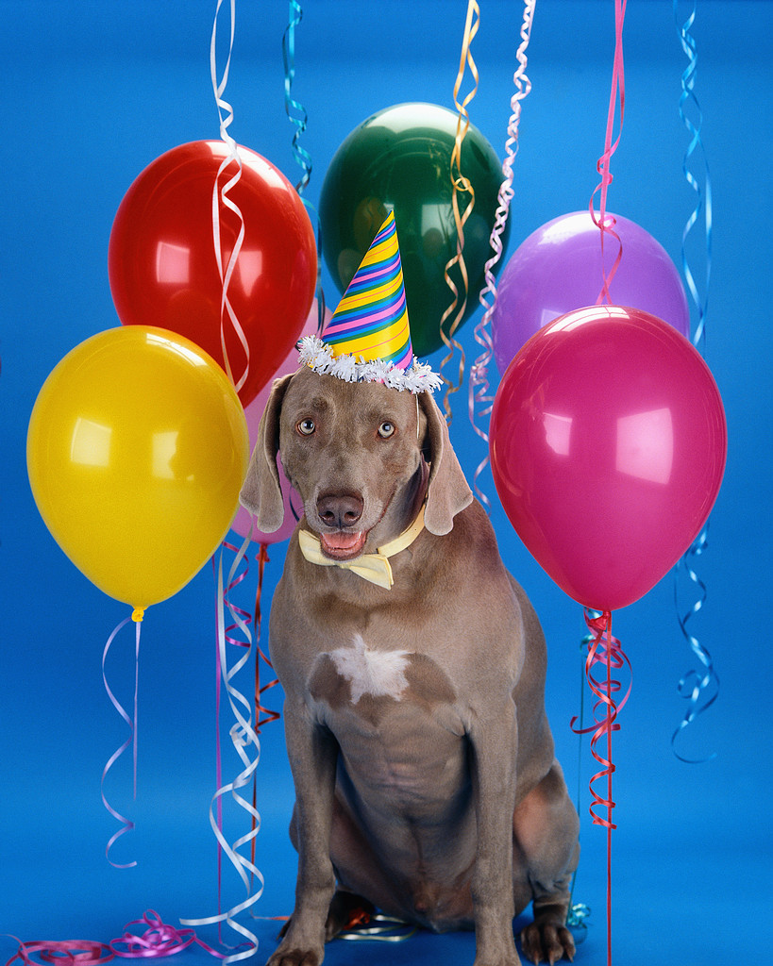
My Family
I have 1 sister named Emily, 2 brothers named Joshua and Adam, 1 mom , 1 dad,1 dog named Bailey and she is so cute.

Slide 4
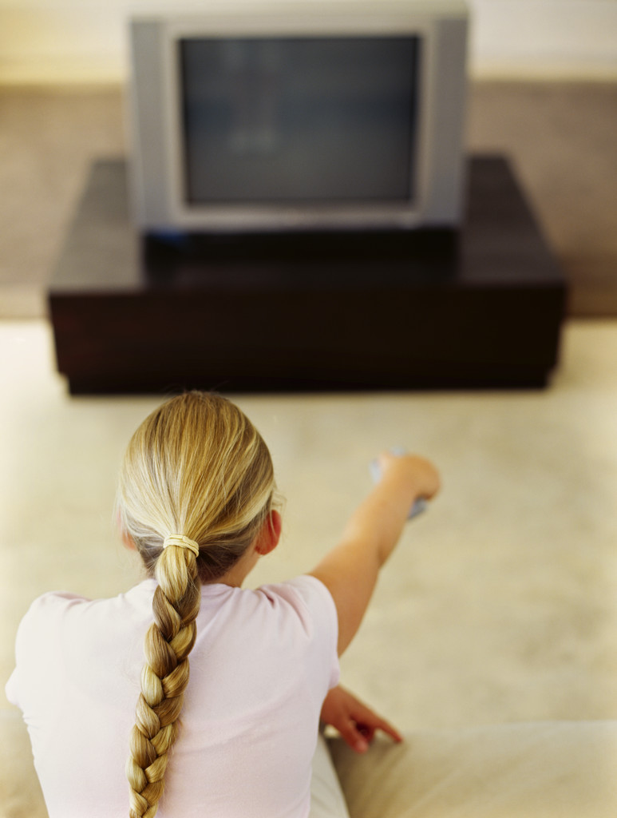
My Top Favorites
I like the TV show Duck Dynasty. Some of my favorite food is meat and macaroni My favorite color is hot pink.

Slide 5
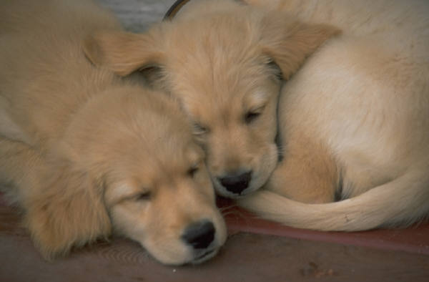
My Hobbies
I like to collect rocks and minerals for fun.
I like playing soccer for fun.
I like looking at cute doggies and puppies on the computer for fun.
I like hunting and fishing for lots of food.

Slide 6
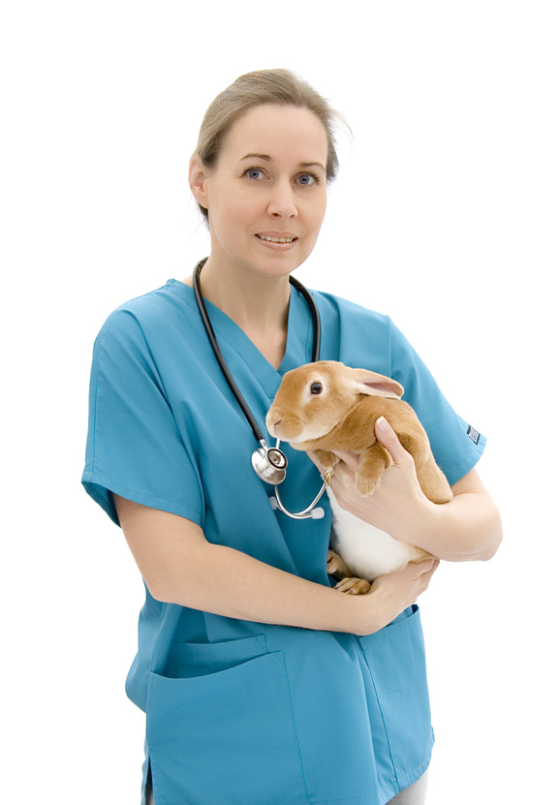
My Goals
My goals are getting a goal in soccer and being nice to my siblings.
When I grow up I want to be a veterinarian and help and save other animals.

