Slide 1
My Amazing Life
By Ronnie

Slide 2
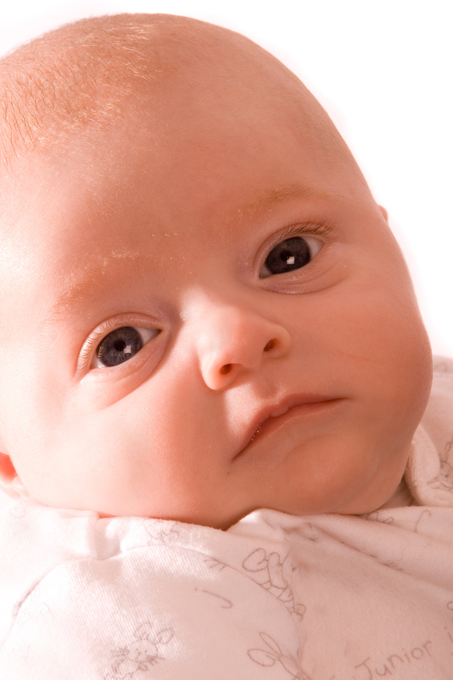
When I was born
I was born in May 5, 2005. I was born in St.Louis, Missouri.

Slide 3
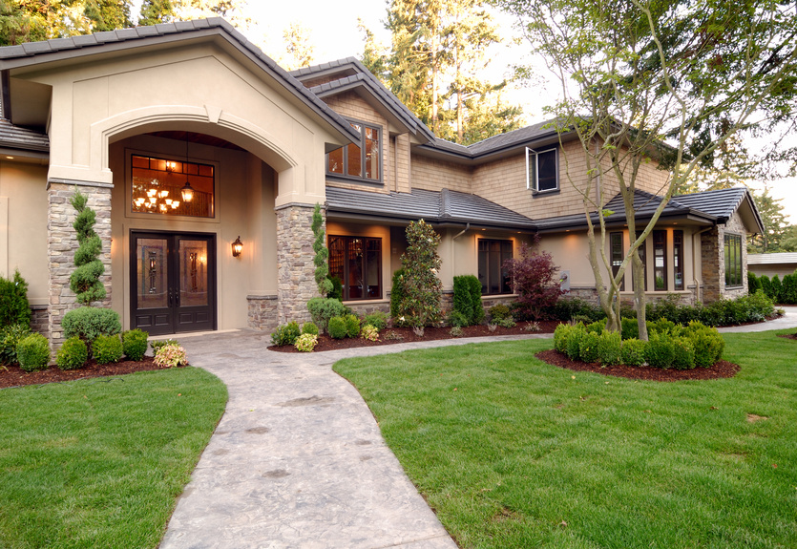
My Family
I live wife three dogs and I have no brothers or sisters but I am still happy.

Slide 4
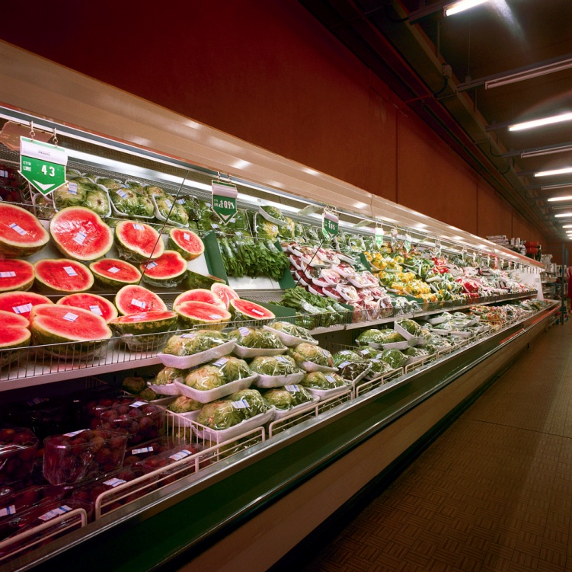
Some of my favorites
Some are grapes, carrots and I help wife the foods sometimes and clean dishes.

Slide 5
Hobbies
I like to do soccer because it is good to do something good for you.

Slide 6
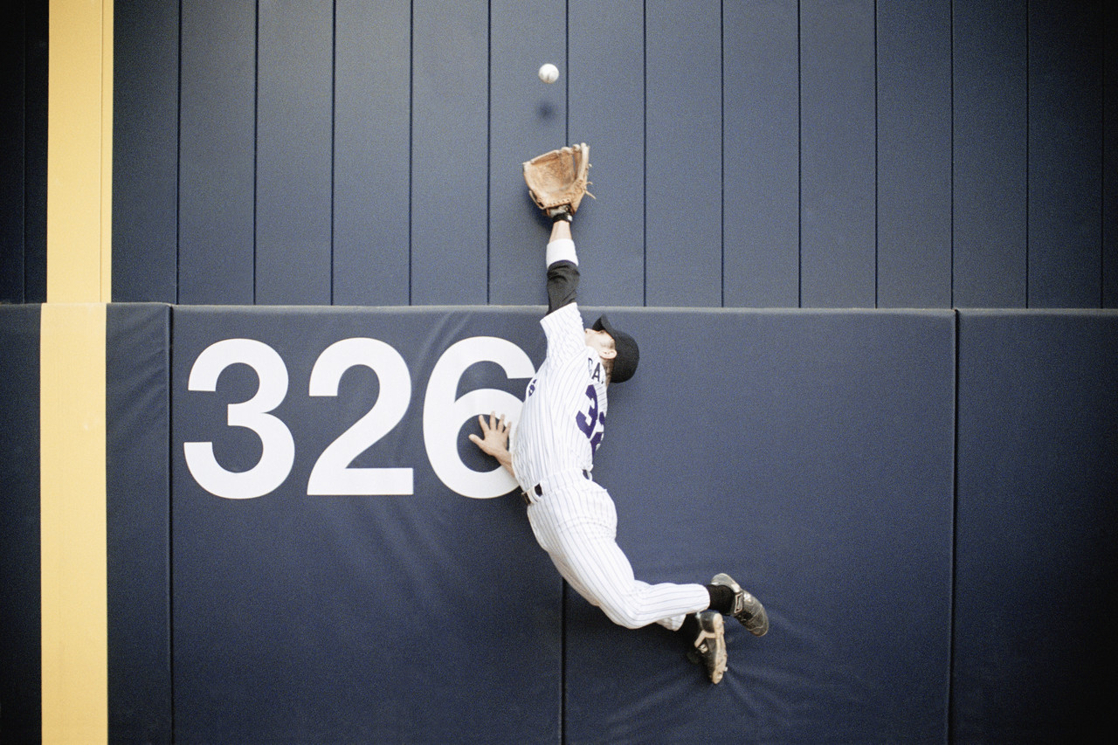
Goals
My goals are to be a baseball player and to be awesome.

