Slide 1
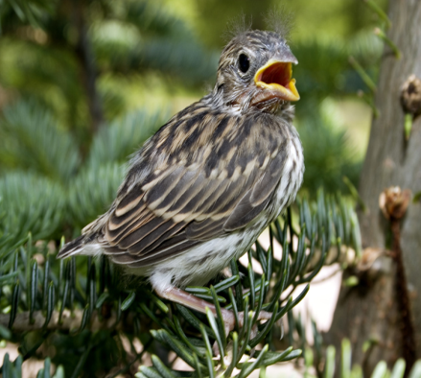
I Am Who I Am
By Lydia Madison Bowers

Slide 2
When I Was Born
I was born on September, 10th, 2004.I was born at St. Johns hospital St. Louis, Missouri!

Slide 3
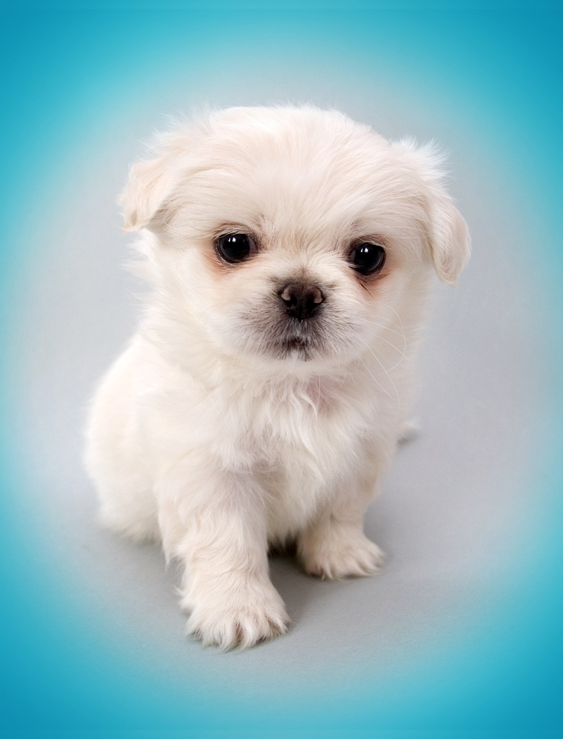
My Family
I am a lonely child and I have a mom named Lauren and a dad named Mitchell. I have one dog named Chloe and two cats named Molly and Mia. And about sevendy five family members in my family.

Slide 4
My Total Favorites
My favorite food is meat. My favorite color is blue, yellow, green, purple, and blue.

Slide 5
My Hobbies
I like to collect Pokémon cards. I like to play all kinds of sports like: kick ball, soccer and fun stuff like that. I basically love cute little animals.

Slide 6
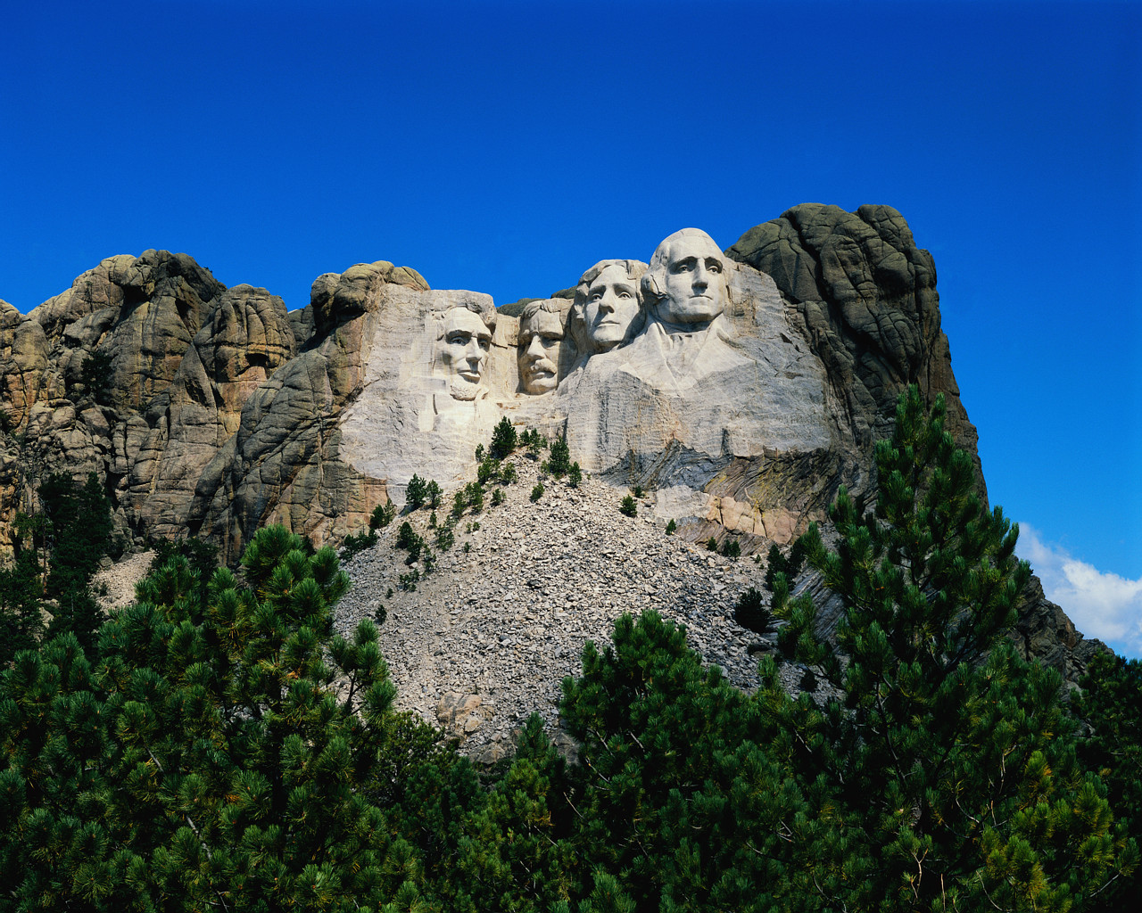
My Goals
When I grow up I want to be a astronaut and rule the world! When I grow up to be famas and be kind to all people of the world so I can be president or even mayor and like I said in the I WILL rule the world soon. I will always love Mind craft.

